Slide 1


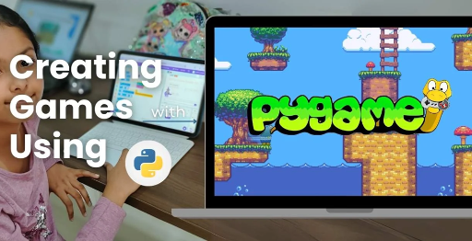
Session 9
Power-ups & Basic Game Strategy

Slide 2
Learning Objectives
Understand game inspiration, install Pygame-CE, navigate project structure
Detailed Objectives:
Objectives:
Implement power-ups for the Basic Game mode (e.g., double damage, full trajectory view).
Manage limited-use enhancements to add strategic depth.
Integrate power-ups into gameplay flow.

Slide 3
Practical Tasks
Understand game inspiration, install Pygame-CE, navigate project structure
Below is the list of Practical Tasks:
Update Powerup class in classes.py to define two power-ups (e.g., double damage, show full trajectory).
Add power-up activation logic in game_modes.py for Basic Game mode.
Create power-up icons in media/ and load them via assets.py.
Test power-up effects by applying them during a bird launch.

Slide 4
Deliverables
Understand game inspiration, install Pygame-CE, navigate project structure
Session Deliverables:
classes.py and game_modes.py with two functional power-ups.
Power-up icons displayed and usable in Basic Game mode.
Tips:
Brainstorm creative power-up ideas with your team.
Test power-ups one at a time to ensure they work.

Slide 5
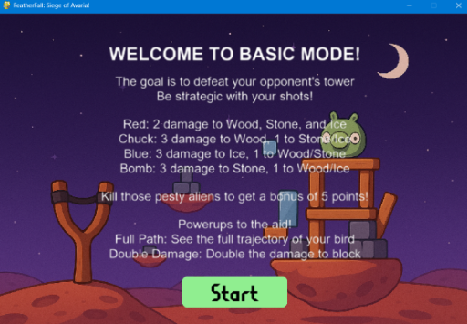
OMOGAME - Power-Ups & Basic Game Strategy in PyGame
⚡ Power-Ups & Basic Game Strategy in PyGame
👉 Train students to code, activate, and integrate power-up mechanics for strategic depth in gameplay.

Slide 6
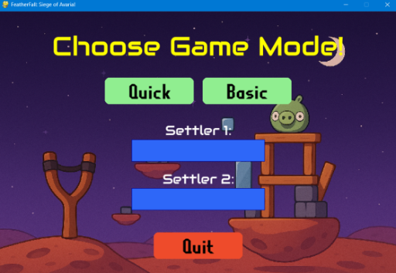
OMOGAME - Power-Ups & Basic Game Strategy in PyGame
⚡ Power-Ups & Basic Game Strategy in PyGame
👉 Train students to code, activate, and integrate power-up mechanics for strategic depth in gameplay.

Slide 7
Supercharge Your Game
⚡ Supercharge Your Game
👉 “Adding Power-Ups to Make Gameplay Smarter, Stronger, and Strategic”
Introduce the topic and how power-ups are used in the Basic Game Mode of OMOGAME.
“Adding Power-Ups to Make Gameplay Smarter, Stronger, and Strategic”
Introduce power-ups in OMOTEC-PyGame: Siege of Avaria!
Enhance Basic Mode with strategic gameplay elements.
Inspired by Angry Birds, players launch birds to destroy fortresses.
Learn to implement power-ups using Pygame-CE.
Focus: Add excitement and tactics to two-player battles.

Slide 8
What Are Power-Ups?
⚡ What Are Power-Ups?
Temporary boosts that affect gameplay
Available in Basic Mode only
Examples:
🎯 Double Damage
👁️ Full Trajectory Preview
📌 Designed to add excitement and tactics to bird launching.
Temporary boosts that alter gameplay dynamics.
Exclusive to Basic Mode in Siege of Avaria!
Examples:
🎯 Double Damage: Doubles bird impact damage.
👁️ Full Trajectory Preview: Shows complete bird flight path.
Add excitement and strategic depth to bird launching.
Encourage thoughtful decision-making in gameplay.
Increase replayability with varied effects.

Slide 9
Power-Up Module Map
⚡ Power-Up Module Map
Module Role in Power-Ups
classes.py Defines the PowerUp class & logic
game_modes.py Manages activation flow in Basic Game
assets.py Loads icons & effects
media/ Stores icons (e.g., lightning, radar)
🧠 Think modular: each file plays a small, powerful part.
classes.py: Defines PowerUp class with attributes and logic.
game_modes.py: Controls power-up activation in Basic Mode.
assets.py: Loads power-up icons and visual effects.
media/: Stores icons (e.g., lightningthink mode
tools.py: Renders power-up visuals on screen.
Modular design ensures seamless power-up integration.
Each module plays a critical role in functionality.

Slide 10
Creating the PowerUp Class
⚡ Creating the PowerUp Class
class PowerUp:
def __init__(self, type, active=False):
self.type = type
self.active = active
Add attributes: duration, cooldown, visual state
Extend with methods like apply_to_bird(bird)
In classes.py:
class PowerUp:
def __init__(self, type, active=False):
self.type = type
self.active = active
self.duration = 1
self.cooldown = 0
Attributes: type, active, duration, cooldown.
Method apply_to_bird(bird) modifies bird properties (e.g., damage).
Supports power-ups like Double Damage and Trajectory Preview.
Ensures temporary effects with controlled duration.

Slide 11
Activating Power-Ups in Basic Mode
⚡ Activating Power-Ups in Basic Mode
In game_modes.py:
Check power-up availability during player's turn
Apply effects when bird is launched
if powerup.type == "double_damage":
bird.damage *= 2
💡 Use flags like powerup_used = True to prevent re-use
In game_modes.py:
if powerup.active and powerup.type == "double_damage":
bird.damage *= 2
powerup_used = True
Check power-up availability during player’s turn.
Apply effects when bird is launched.
Use powerup_used = True flag to prevent reuse.
Reset after turn via game_modes.py logic.
Integrates with turn-based gameplay flow.

Slide 12
Visualizing Power-Ups in the UI
⚡ Visualizing Power-Ups in the UI
Add power-up icons to the game screen
Load with assets.py
Display above HUD or next to player info
screen.blit(powerup_icon, (x, y))
📦 Bonus: Flash effect when power-up is activated
Load icons in assets.py: pygame.image.load("media/double_damage.png").
Display icons above HUD or next to player info:
screen.blit(powerup_icon, (x, y))
Store icons in media/ (e.g., lightning, radar).
Bonus: Add flash effect on activation via tools.py.
Enhances player feedback and UI clarity.
Renders each frame for consistent visuals.

Slide 13
Testing & Debugging Power-Ups
⚡ Testing & Debugging Power-Ups
🧪 Student steps:
Trigger power-up
Watch damage or trajectory behavior
Use print() to verify activation:
print("Power-Up Applied:", powerup.type)
👉 One power-up at a time makes testing easier
Student steps:
Trigger power-up in Basic Mode.
Observe changes in damage or trajectory behavior.
Verify with: print("Power-Up Applied:", powerup.type).
Test one power-up at a time for clarity.
Check game_modes.py for activation logic.
Ensure assets.py loads correct icons.
Debug using console logs to track state.

Slide 14
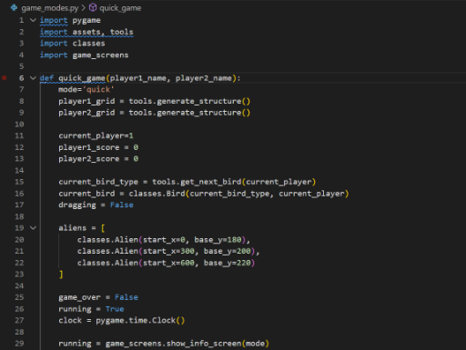
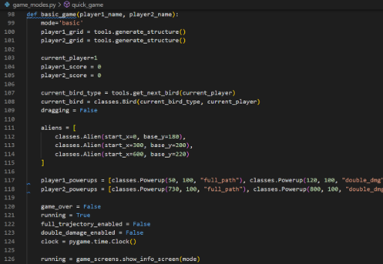
Testing & Debugging Power-Ups
CODE SNIPPETs : GAME MODES

Slide 15
Strategy Through Power-Ups
⚡ Strategy Through Power-Ups
Why power-ups matter in gameplay:
Adds decision-making and resource management
Encourages timing and planning 🧠 Tip: Don’t give both power-ups every turn!
📌 Optional: Let players earn or collect them
Power-ups add decision-making and resource management.
Encourage timing and planning for optimal use.
Limit availability (e.g., one per turn) for balance.
Optional: Players earn power-ups via gameplay actions.
Enhance strategic depth in Basic Mode battles.
Prevent overuse to maintain fair competition.
Make every choice impactful for victory.

Slide 16
Student Exercise Challenge – Design & Code a New Power-Up
⚡ Student Challenge – Design & Code a New Power-Up
Create a new power-up:
Name it
Code its effect
Add a unique icon
Test in a mock gameplay session
🎯 Examples: “Triple Shot”, “Freeze Alien”, “Reverse Gravity”
Task:
Name a new power-up (e.g., “Triple Shot”, “Freeze Alien”, “Reverse Gravity”).
Code effect in classes.py and game_modes.py.
Create unique icon in media/ (e.g., triple_shot.png).
Test in mock gameplay session via main.py.
Deliverables: Updated code, screenshot of activation.
Save as: my_powerup.py.
Submit for feedback on creativity and functionality.

Slide 17
Session Recap – Coding with Strategy
⚡ Recap – Coding with Strategy
✅ What you’ve achieved:
PowerUp class coded and applied
Logic added to Basic Game
Icons integrated into the screen
Strategic gameplay decisions enabled
💡 Tip: Plan your power-up flow in a sketch before coding!
Achievements:
Coded PowerUp class in classes.py.
Integrated logic into Basic Mode via game_modes.py.
Added icons to UI with assets.py and media/.
Enabled strategic gameplay decisions.
Design tip: Sketch power-up flow before coding.
Reference: Pygame CE Documentation (https://pyga.me/docs/).

Slide 18

Exercise:
1. What is the primary objective of the Quick Mode in OMOGAME?
A) Collect all power-ups before the opponent
B) Launch birds without any destruction
C) Reach a score of 200 points
D) Complete the entire storyline
Answer: C) Reach a score of 200 points
2. Which file is considered the main entry point of the OMOGAME project? A) tools.py
B) main.py
C) assets.py
D) classes.py
Answer: B) main.py

Slide 19
Exercise..
3. What does the tools.py file mainly handle in the game?
A) Launching sound and animation
B) Player avatar selection
C) Collision detection and drawing functions
D) Managing game instructions
Answer: C) Collision detection and drawing functions
4. Which of the following is NOT listed as a unique feature of OMOGAME? A) Bird classes with special physics
B) Alien targets for bonus points
C) Multiplayer online matchmaking
D) Destructible block environments
Answer: C) Multiplayer online matchmaking

Slide 20
Exercise…
5. Why is organizing the OMOGAME project into files like classes.py, media/, and game_modes.py important?
A) It reduces the game’s memory usage
B) It helps reduce the number of bugs completely
C) It makes the project look colorful
D) It simplifies managing and updating different game parts
Answer: D) It simplifies managing and updating different game parts

Slide 21
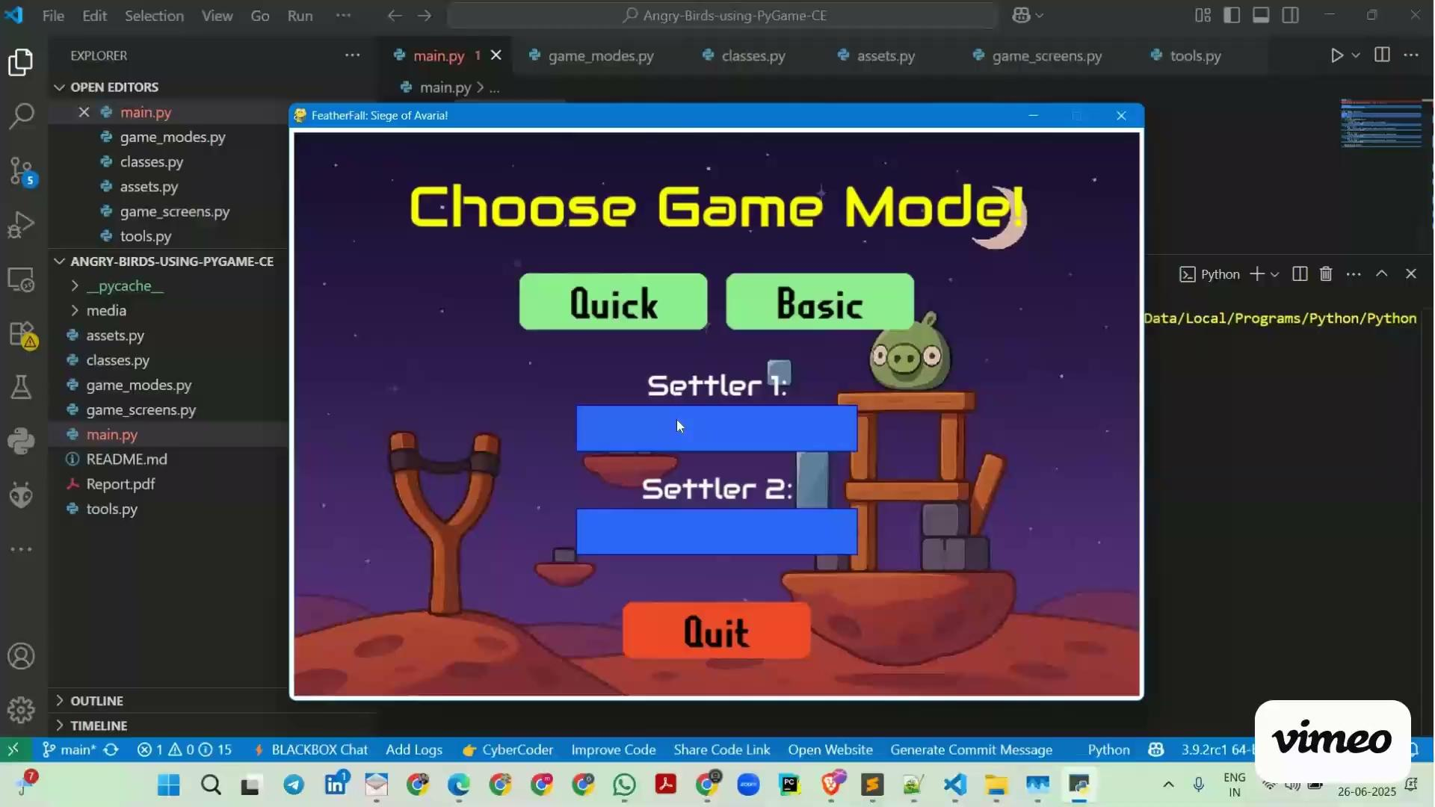
Session 9 VIDEO LINK
Power-ups & Basic Game Strategy

